Slide 1
Mikrodenetleyiciler: Uygulamalar

Slide 2
What Is Arduino?
The term Arduino is used to describe both the physical Arduino board (of which the most popular type is the Arduino Uno) and the Arduino system as a whole.
The system also includes the software you need to run on your computer (to program the board) and the peripheral shields that you can plug into an Arduino board.
To use an Arduino, you also need a “proper” computer. This can be a Mac, Windows PC, Linux PC, or even something as humble as a Raspberry Pi.
The main reason that you need the computer is so you can download programs onto the Arduino board.
Once installed on the Arduino, these programs can then run independently.

Slide 3
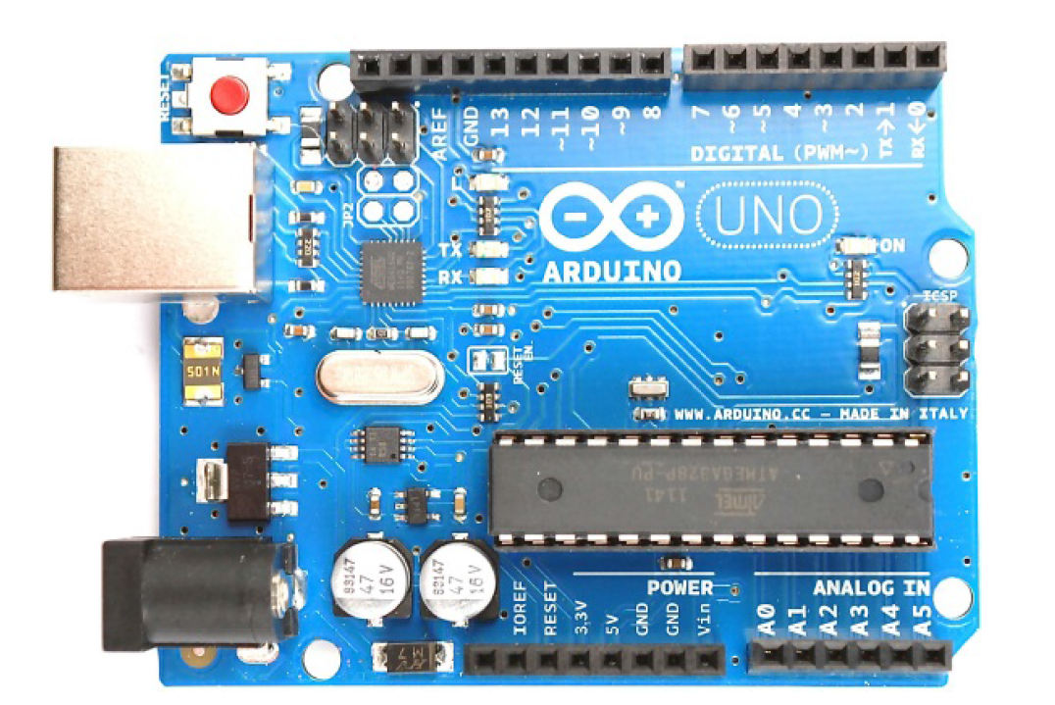

Slide 4
An Arduino is unlike a conventional computer in that it has hardly any memory, no operating system, and no keyboard mouse or screen interface.
Its purpose is to control things by interfacing with sensors and actuators.
So, for instance, you might attach a sensor to measure the temperature and a relay to control the power to a heater.
Figure shows some of the things that you can attach to an Arduino board.
There are no doubt many more types of devices that you can connect to an Arduino board.

Slide 5
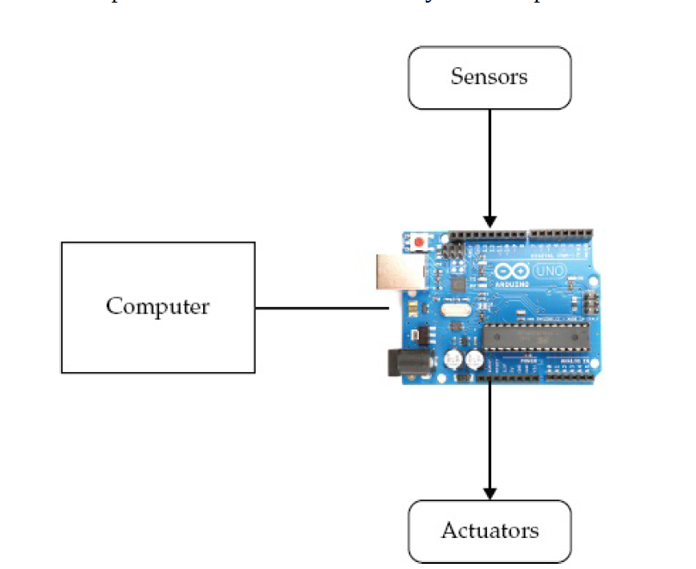

Slide 6
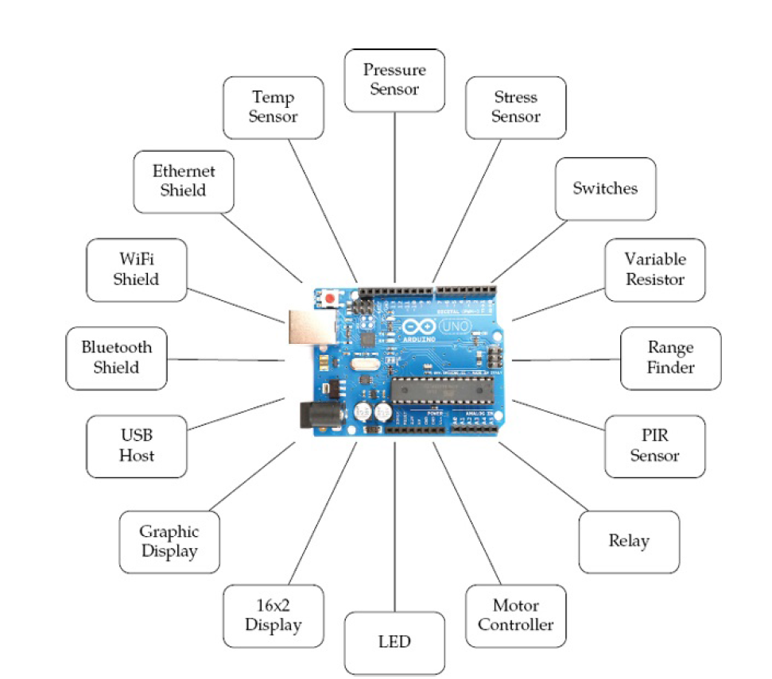

Slide 7
Installation and the IDE
The software that you use to program the Arduino is called the Arduino Integrated Development Environment (IDE).
If you are a software developer and accustomed to using complex IDEs like Eclipse or Visual Studio, you’ll find the Arduino IDE very simple—and possibly find yourself wishing for repository integration, command completion, and the like.
If you are relatively new to programming, you will love the Arduino’s simplicity and ease of use.
Installing the IDE: The first step is to download the software for your type of computer from the official Arduino website:
http://arduino.cc/en/Main/Software.
Once you’ve downloaded the software, then you can find detailed installation instructions for each platform here:
http://arduino.cc/en/Guide/HomePage.
One of the nice things about the Arduino is that all you need to get started is an Arduino, a computer, and a USB lead to connect the two. The Arduino can even be powered over the USB connection to the computer

Slide 8
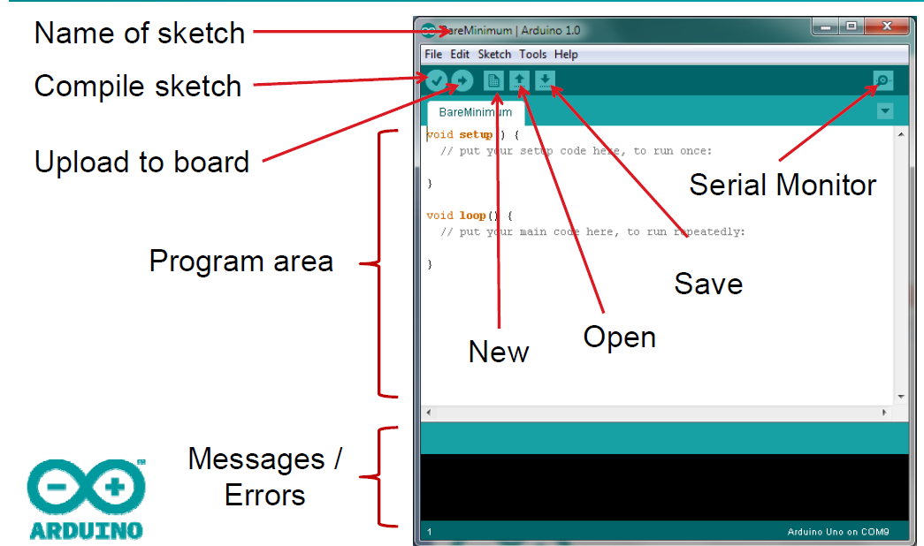

Slide 9
To prove that the Arduino is working, we are going to program it to flash an LED that is labeled L on the Arduino board and hence is known as the “L” LED.
Start by launching the Arduino IDE on your computer.
Then, from the File menu, (Figure) select Examples | 01 Basics | Blink.

Slide 10
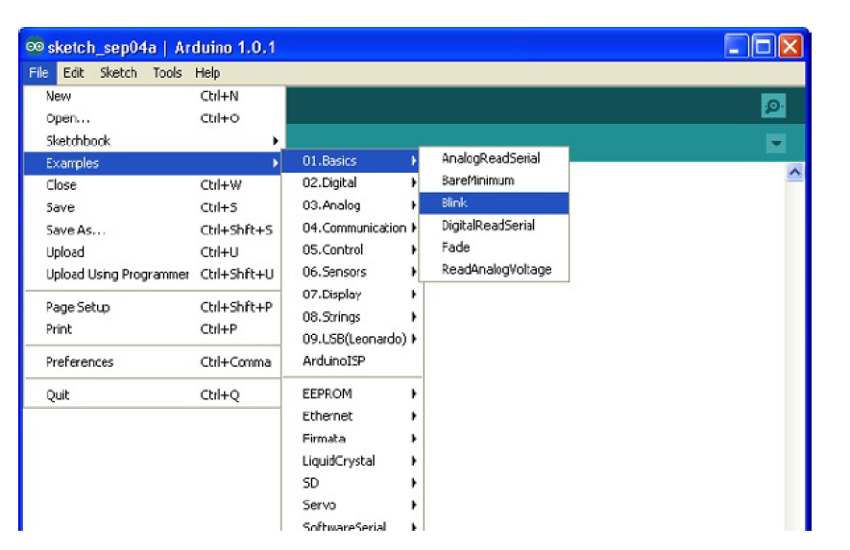

Slide 11
In an attempt to make programming the Arduino sound less daunting to nonprogrammers, programs on the Arduino are referred to as sketches.
Before you can send the Blink sketch to your Arduino, you need to tell the Arduino IDE what type of Arduino you’re using. The most common type is the Arduino Uno.
As well as selecting the board type, you also need to select the port it is connected to.
In Windows this is easy, as it is usually COM4 and will probably be the only port in the list.
On a Mac or Linux computer, however, there will generally be more serial devices listed.
The Arduino IDE shows the most recently connected devices first, so your Arduino board should be at the top of the list.

Slide 12
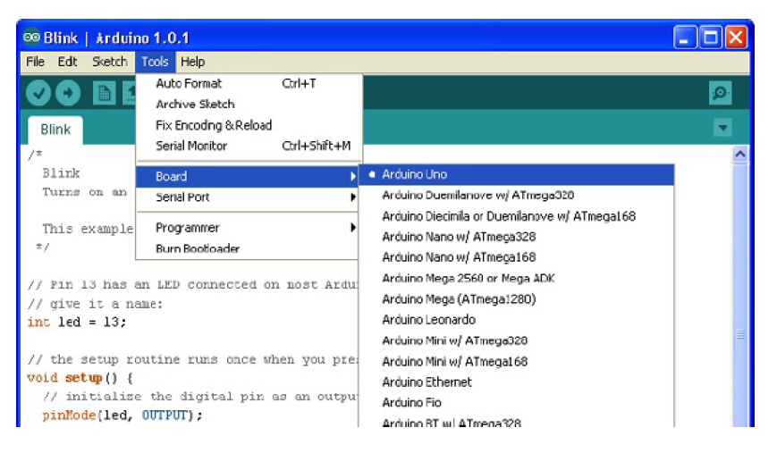

Slide 13
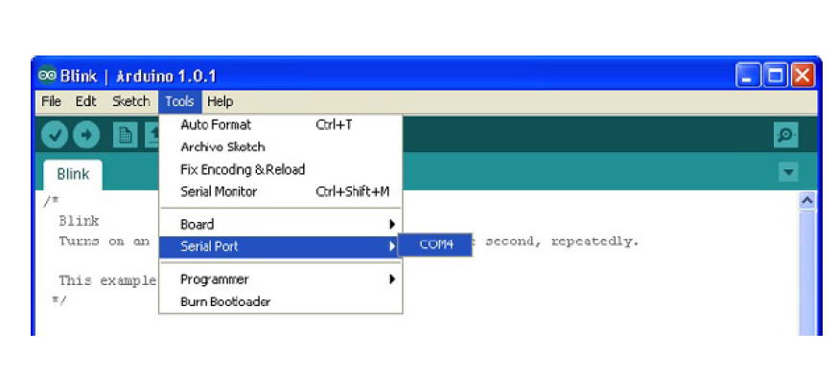

Slide 14
To actually upload the sketch onto the Arduino board, click the Upload
button on the toolbar. This is the second button on the toolbar.
Once, you click the Upload button, a few things should happen.
First, a progress bar will appear as the Arduino IDE compiles the sketch (meaning it converts the sketch into a suitable form for uploading).
Then, the LEDs on the Arduino labeled Rx and Tx should flicker for a while. Finally, the LED labeled L should start to blink.
The Arduino IDE will also display a message like “Binary sketch size: 1,084 bytes (of a 32,256 byte maximum).” This means the sketch has used about 1kB of the 32kB of the flash memory available for programs on the Arduino.

Slide 15
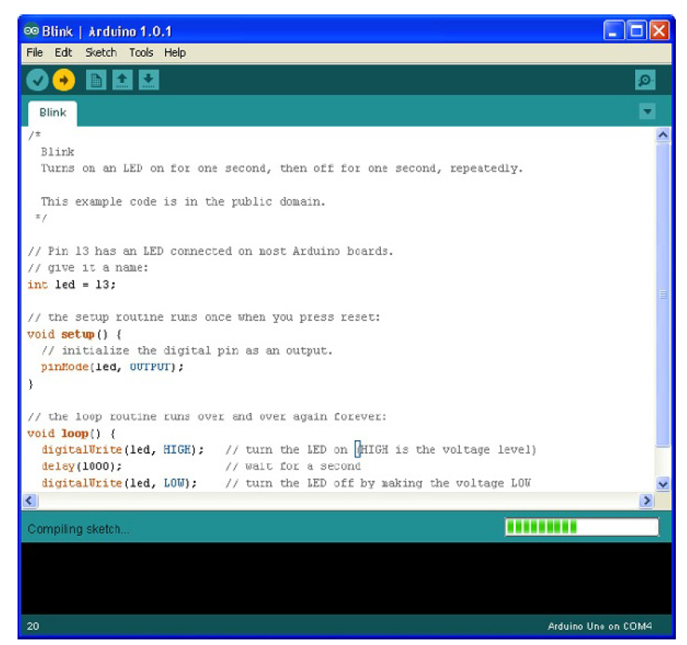

Slide 16
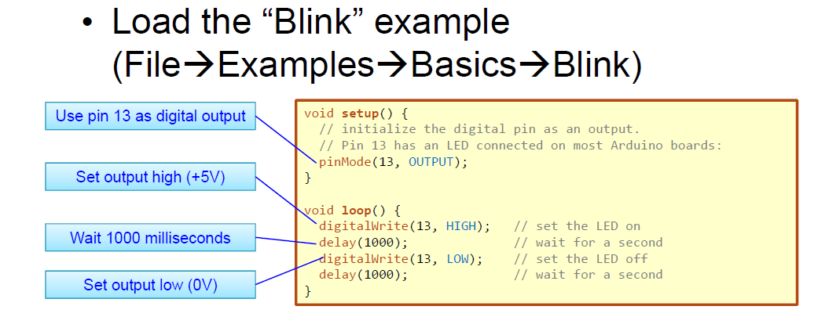

Slide 17
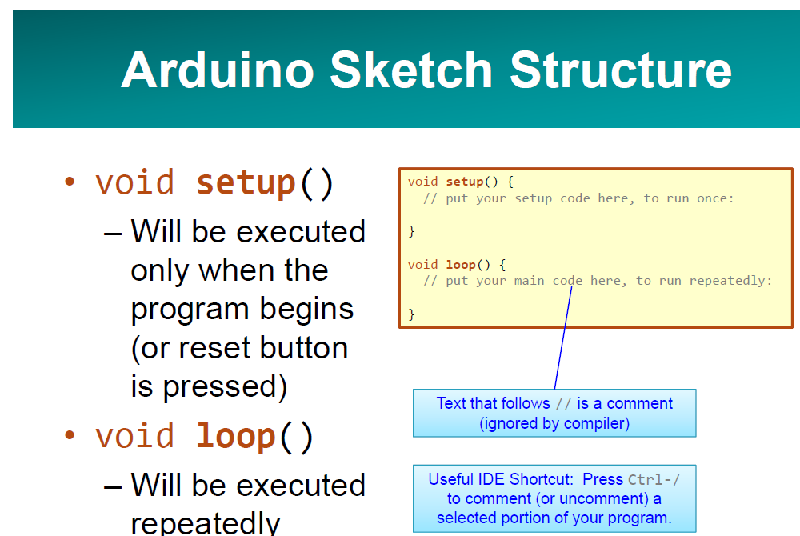

Slide 18
Figure the anatomy of an Arduino Board.
Starting at the top, next to the USB socket in the top-left corner, is the Reset switch. Clicking this sends a logic pulse to the microcontroller’s Reset pin, clearing the microcontroller’s memory so it can start its program fresh. Note that any program stored on the device is retained because it is kept in nonvolatile flash memory—that is, memory that remembers even when the device is not powered on.
Power Supply
The Arduino can either be powered through either the USB connection or the DC power. When powering the Arduino from a DC adaptor or batteries, anything between 7.5 and 12V DC can be supplied through the power socket. The Arduino itself only uses about 50mA. So a small PP3 9V battery (200mAh) will power it for around 40 hours. When the Arduino is powered on, the power LED on the right of the Uno is lit.

Slide 19
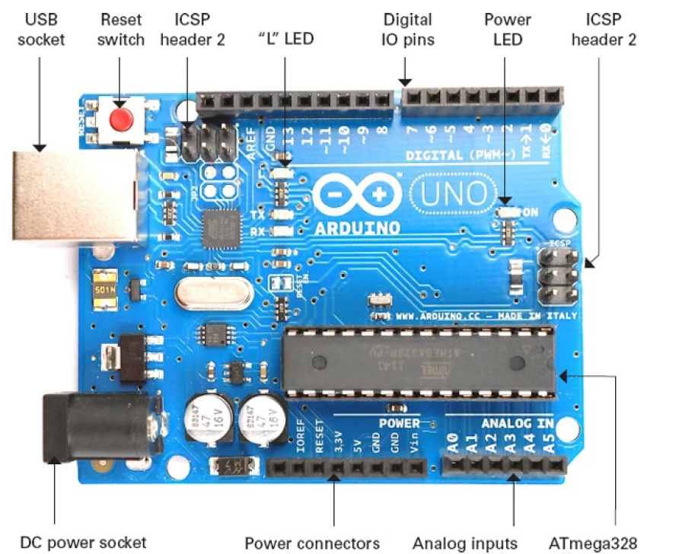

Slide 20
Apart from the first connection, you can read the connection names next to the connectors. The first unlabeled connection is reserved for later use.
The next pin, IOREF, indicates the voltage at which the Arduino operates. Both the Uno and Leonardo operate at 5V, so this pin will always be set at 5V. Its purpose is to allow shields attached to 3V Arduinos like the Arduino Due to detect the voltage at which the Arduino operates.
The next connect is Reset. This connection does the same thing as pressing the Reset switch on the Arduino. Rather like rebooting a PC, it resets the microcontroller to begin its program from the start. The Reset connector allows you to reset the microcontroller by momentarily setting this pin low (connecting it to GND).
The remaining pins provide different voltages (3.3, 5, GND, and 9), as labeled. GND, or ground, just means zero volts. It is the reference voltage to which all other voltages on the board are relative. The two GND connections are identical; having more than one GND pin to connect things to is useful. In fact, there is another GND socket at the top of the board.

Slide 21
Analog Inputs
The next section of connections is labeled Analog In 0 to 5.
These six pins can be used to measure the voltage connected to them so the value can be used in a sketch. Although labeled as analog inputs, these connections can also be used as digital inputs or outputs. By default, however, they are analog inputs.
Digital Connections: Now let’s switch to the top connector, starting on the right side. We have pins labeled Digital 0 to 13.
These can be used as either inputs or outputs. When using them as outputs, you can control them from a sketch. If you turn them on from your sketch, they will be at 5V, and if you turn them off, they will be at 0V.
As with the supply connectors, you have to be careful not to exceed their maximum current capabilities.
These connections can supply 40mA at 5V—more than enough power to light a standard LED, but not enough to drive an electric motor directly.

Slide 22
The other types of Arduino board all satisfy special requirements, like the need for more I/O (input/output) connections, faster performance, or a smaller board, or to be stitched into clothing, connect to Android phones, or integrate easily with wireless and so on.
No matter how different the hardware, each board is programmed from the Arduino IDE, with only minor variations in the software features they can use.
Once you have learned how to use one Arduino Board, you have pretty much learned how to use all of them.
Let’s look at the current range of official Arduino boards. There are other Arduinos than the ones discussed here, but they tend not to be that popular. For a full list of boards, check out the official Arduino website (www.arduino.cc).

Slide 23
The Uno R3 is the latest of a series of “standard” boards that include the plain Uno, Duemilanove, Diecimila, and NG.
These boards all use the ATmega168 or ATmega328 microprocessors, which are pretty much the same, apart from differing amounts of memory.
The other current Arduino, with the same size and connections as the Uno R3, is the Arduino Leonardo . As you can see, the board is much more sparsely populated than the Uno. This is because it uses a different processor.
The Leonardo uses the ATmega32u4, which is similar to the ATmega328 but includes a built-in USB interface, removing the need for the extra components that you find on the Uno.
Moreover, the Leonardo has slightly more memory, more analog inputs, and other benefits.
It is also less expensive than the Uno. In many respects, it is also a better design than the Uno.

Slide 24
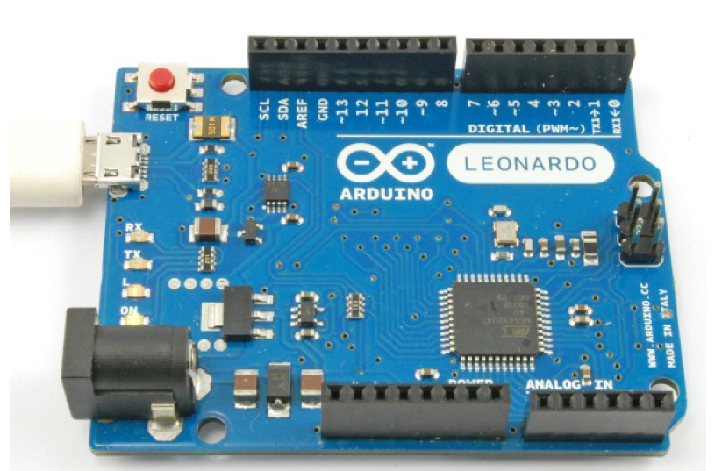

Slide 25
Big Arduino Boards
Sometimes an Uno or Leonardo just doesn’t have enough I/O pins for the application that you intend to use it for. The choice then arises of either using hardware expansion for the Uno or switching to a bigger board.
TIP If you are coming to Arduino for the first time, do not buy one of these larger boards. It is tempting because they are bigger and faster, but they have shield compatibility problems and you will be much better off with a “standard” Uno.
The super-sized Arduinos have the same sockets as an Uno, but then they add a double row of extra I/O pins on the end and a longer length of pins along the side.

Slide 26
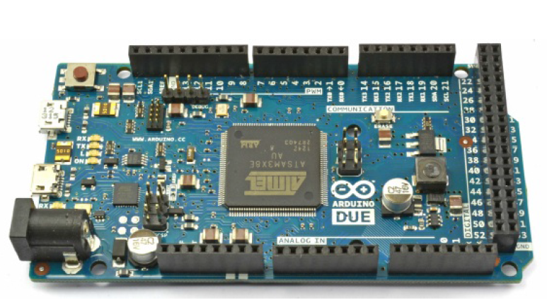

Slide 27
Traditionally, the “bigger” board would be an Arduino Mega 2560. These boards, in common with all the larger Arduino boards, have more of every kind of memory.
The Mega 2560 and Mega ADK both use processors with similar power to the Arduino Uno. However, the Arduino Due is an altogether more powerful beast.
This power comes in the form of a 84 MHz processor (compared with the Uno’s 16 MHz) but at the cost of further compatibility problems.
The biggest of these is that the Due operates at 3.3V rather than the 5Vs of most previous Arduinos. Not surprisingly, this means that many Arduino shields are incompatible with it.
For the most demanding projects, however, this board has many advantages.
• Lots of memory for programming and data
• Hardware music output capabilities (hardware digital to analog converters)
• Four serial ports
• Two USB ports
• USB host and OTG interfaces
• USB keyboard and mouse emulation

Slide 28
Small Arduino Boards
Just as the Uno is too small for some projects, it can also be too big for others. Although Arduino boards are low cost, it gets expensive if you start leaving one embedded in every project you make.
There are a range of smaller and “pro” Arduino boards, designed either to be physically smaller than a regular Uno or to keep costs down by omitting features not required in most projects.
Figure shows an Arduino Mini.
These boards do not have a USB interface; rather, you need a separate adaptor module to program them. As well as the Mini, there are also Nanos and Micros, both of which have built-in USB but cost more.

Slide 29
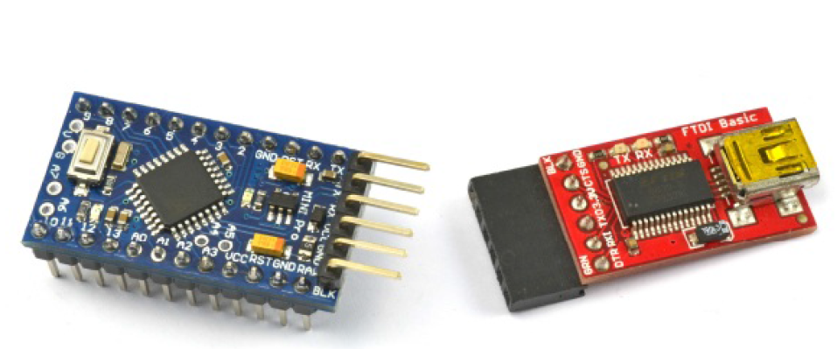

Slide 30
LilyPad and LilyPad USB Boards
One of the most interesting Arduino styles is the LilyPad and the newer LilyPad USB.
These boards are designed to be stitched into clothing using conductive threads and a range of similar LilyPad modules—for LEDs, switches, accelerometers, and so on.
The older LilyPad boards require a separate USB interface, the same one required for the Arduino Mini.
However, these boards are gradually being replaced by the Arduino LilyPad USB, which has a built-in USB connector.

Slide 31
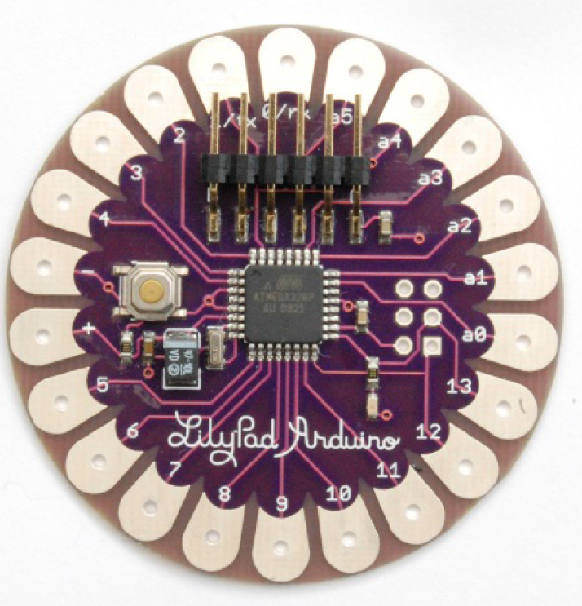

Slide 32
Unofficial Arduinos
As well as the “official” boards just described, there are also many unofficial copies and variations on the Arduino hardware, given its open source status. Straight Arduino clones are easy to come by on eBay and other low-cost outlets and are simply copies of the Arduino designs. They are only really of interest because of their price.
There are also some interesting Arduino-based designs that offer extra features. Two examples of these kind of boards that are worth looking at are
• EtherTen Arduino Ethernet-type board
(www.freetronics.com/products/etherten)
• Leostick A slim-line Leonardo-type board with built-in USB plug
(www.freetronics.com/collections/arduino/products/leostick)

Slide 33
Programming Language
A common misconception about Arduinos is that they have their own programming language. Actually, they are programmed in the language simply called C.
This language has been around since the early days of computing. What Arduino does provide is a nice easy-to-use set of commands written in C that you can use in your programs. Purists may wish to point out that Arduino uses C++, the bject-oriented extension to C.
Although, strictly speaking, this is true, having only 1 or 2kB of memory available generally means that the kinds of habits encouraged by object oriented programming are not normally a good idea with Arduino, so aside from a few specialized areas, you are effectively programming in C.

Slide 34
Modifying the Blink Sketch
It may be that your Arduino was already blinking when you first plugged it in.
That is because the Arduino is often shipped with the Blink sketch installed.
If this is the case, then you might like to prove to yourself that you have actually done something by changing the blink rate.
Let’s look at the Blink sketch to see how to change it to make the LED blink faster.
The first part of the sketch is just a comment telling you what the sketch is supposed to do. A comment is not actual program code.
Part of the preparation for the code being uploaded is for all such “comments” to be stripped out.
Anything between /* and */ is ignored by the computer, but should be readable by humans.

Slide 35
LED: hello world
// the setup function runs once when you press reset or power the board
int led1=3;
void setup() {
// initialize digital pin LED_BUILTIN as an output.
pinMode(led1, OUTPUT);
}
// the loop function runs over and over again forever
void loop() {
digitalWrite(led1, HIGH); // turn the LED on (HIGH is the voltage level)
delay(2000); // wait for a second
digitalWrite(led1, LOW); // turn the LED off by making the voltage LOW
delay(2000); // wait for a second
}

Slide 36
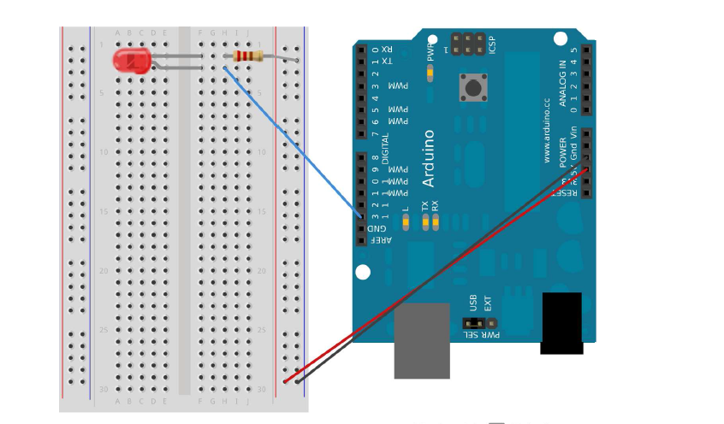

Slide 37
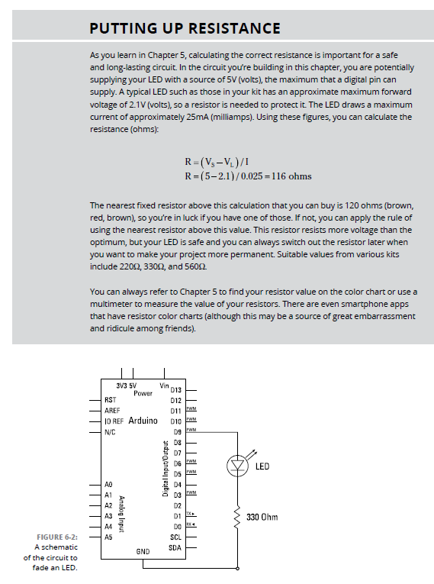

Slide 38
// the setup function runs once when you press reset or power the board
int led1=7;
int delay1=2000;
void setup() {
// initialize digital pin LED_BUILTIN as an output.
pinMode(led1, OUTPUT);
}
// the loop function runs over and over again forever
void loop() {
digitalWrite(led1, HIGH); // turn the LED on (HIGH is the voltage level)
delay(delay1); // wait for a second
digitalWrite(led1, LOW); // turn the LED off by making the voltage LOW
delay(delay1); // wait for a second
}

Slide 39
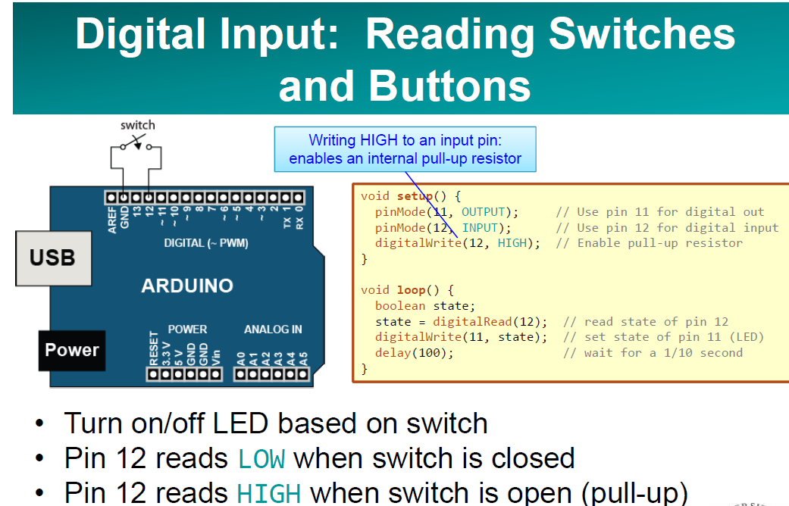
switch

Slide 40
Samples

Slide 41
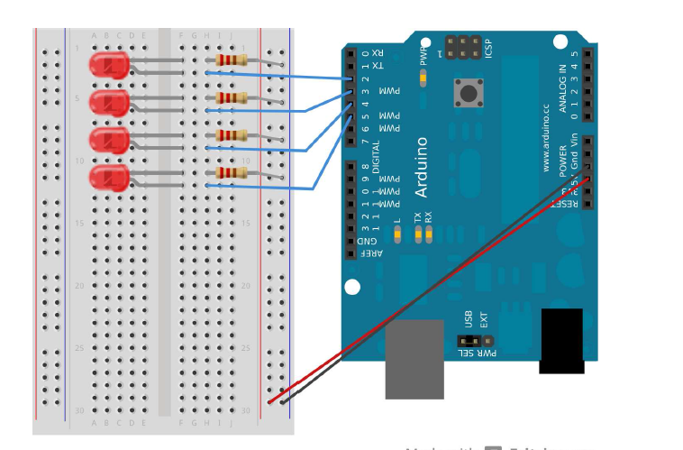

Slide 42
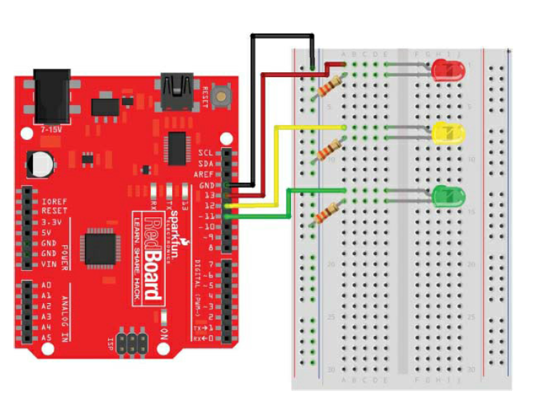

Slide 43
int redPin = 13;
int ylwPin = 12;
int grnPin = 11;
void setup()
{
pinMode(redPin, OUTPUT); //red LED
pinMode(ylwPin, OUTPUT); //yellow LED
pinMode(grnPin, OUTPUT); //green LED
}
void loop()
{
on
digitalWrite(redPin, HIGH); //red
digitalWrite(ylwPin, LOW);
digitalWrite(grnPin, LOW);
delay(2000);
digitalWrite(redPin, LOW); //green on
digitalWrite(ylwPin, LOW);
digitalWrite(grnPin, HIGH);
delay(1500);
digitalWrite(redPin, LOW); //yellow on
digitalWrite(ylwPin, HIGH);
digitalWrite(grnPin, LOW);
delay(500);
}

Slide 45
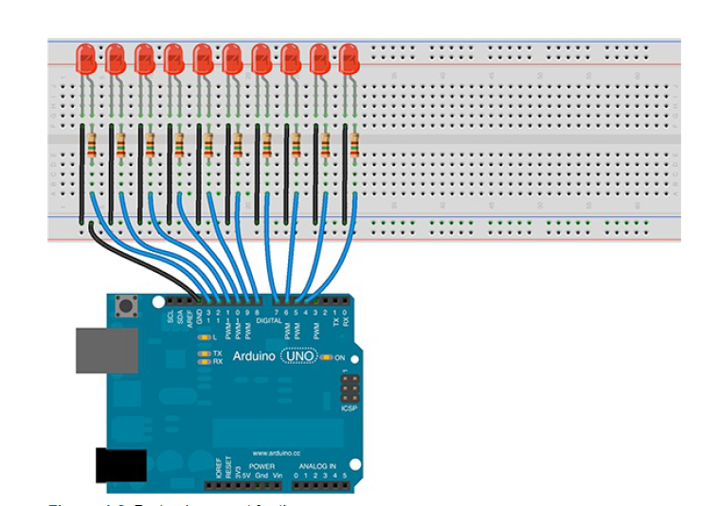

Slide 46
int delayTime = 40; // A variable to set a delay time between each LED
int currentLED = 4; // A variable to store which LED we are currently working on
int dir = 1; // A variable to store the direction of travel
long timeChanged = 0; // A variable to store the last time we changed something
byte ledPin[] = {4, 5, 6, 7, 8, 9, 10, 11, 12, 13}; // An array to hold the value for each LED pin
void setup() {
for (int i=0; i<10; i++) {// Set all pins for OUTPUT
pinMode(ledPin[i], OUTPUT);
}
timeChanged = millis(); // Record the time once the setup has completed
}
void loop() {
if ((millis() - timeChanged) > delayTime) { // Check whether it has been long enough
for (int i=0; i<10; i++) { //turn off all of the LEDs
digitalWrite(ledPin[i], LOW);
}
digitalWrite(ledPin[currentLED], HIGH); // Light the current LED
currentLED = currentLED + dir; // Increase the direction value (up or down)
if (currentLED == 9) { // If we are at the end of a row, change direction
dir = -1;
}
if (currentLED == 0) {
dir = 1;
}
timeChanged = millis(); // store the current time as the time we last changed LEDs
}
}

Slide 48
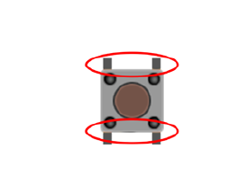
Button

Slide 49
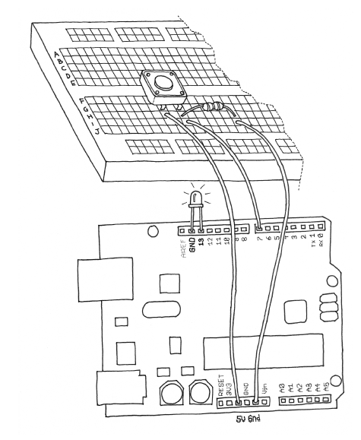

Slide 50
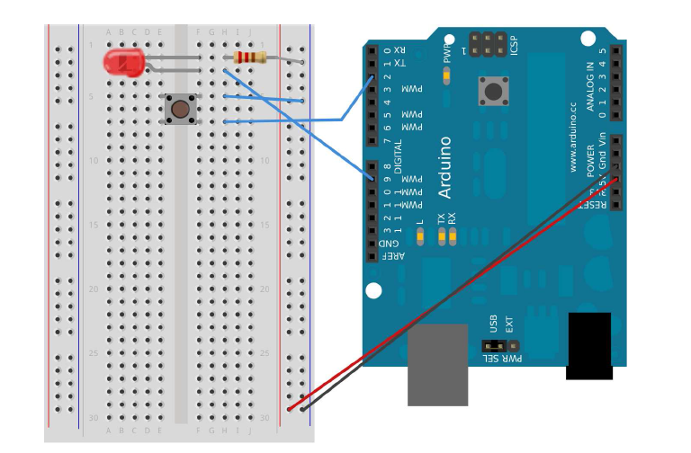

Slide 51
// Turn on LED while the button is pressed
const int LED = 3; // the pin for the LED
const int BUTTON = 7; // the input pin where the
// pushbutton is connected
int val = 0; // val will be used to store the state
// of the input pin
void setup() {
pinMode(LED, OUTPUT); // tell Arduino LED is an output
pinMode(BUTTON, INPUT); // and BUTTON is an input
}
void loop(){
val = digitalRead(BUTTON); // read input value and store it
// check whether the input is HIGH (button pressed)
if (val == HIGH) {
digitalWrite(LED, HIGH); // turn LED ON
} else {
digitalWrite(LED, LOW);
}
}

Slide 52
const int LED = 3; // the pin for the LED
const int BUTTON = 7; // the input pin where the
// pushbutton is connected
int val = 0; // val will be used to store the state
// of the input pin
int state = 0; // 0 = LED off while 1 = LED on
void setup() {
pinMode(LED, OUTPUT); // tell Arduino LED is an output
pinMode(BUTTON, INPUT); // and BUTTON is an input
}
void loop() {
val = digitalRead(BUTTON); // read input value and store it
// check if the input is HIGH (button pressed)
// and change the state
if (val == HIGH) {
state = 1 - state;
}
if (state == 1) {
digitalWrite(LED, HIGH); // turn LED ON
} else {
digitalWrite(LED, LOW);
}
}

Slide 53
const int LED = 3; // the pin for the LED
const int BUTTON = 7; // the input pin where the
// pushbutton is connected
int val = 0; // val will be used to store the state
// of the input pin
int old_val = 0; // this variable stores the previous
// value of "val"
int state = 0; // 0 = LED off and 1 = LED on
void setup() {
pinMode(LED, OUTPUT); // tell Arduino LED is an output
pinMode(BUTTON, INPUT); // and BUTTON is an input
}
void loop(){
val = digitalRead(BUTTON); // read input value and store it
// yum, fresh
// check if there was a transition
if ((val == HIGH) && (old_val == LOW)){
state = 1 - state;
}
old_val = val; // val is now old, let's store it
if (state == 1) {
digitalWrite(LED, HIGH); // turn LED ON
} else {
digitalWrite(LED, LOW);
}
}

Slide 54
Pot

Slide 55
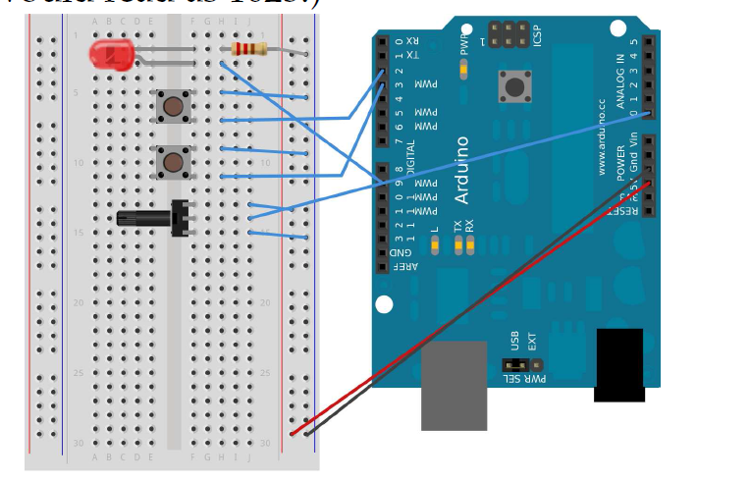

Slide 56
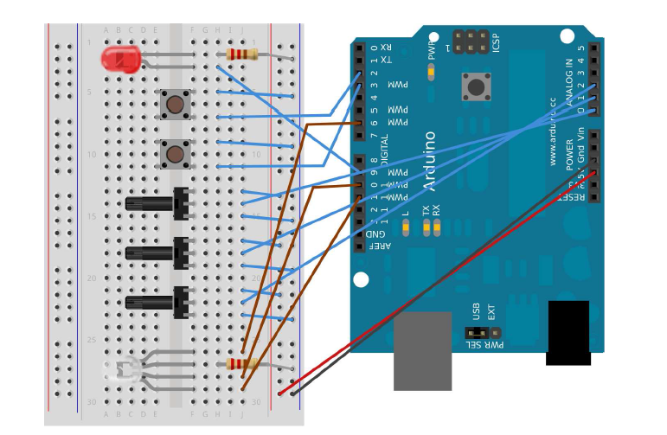

Slide 57
Sound

Slide 58
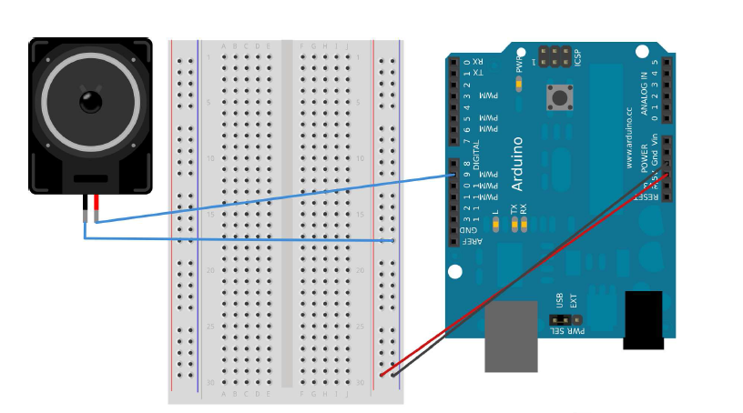

Slide 59
display

Slide 60
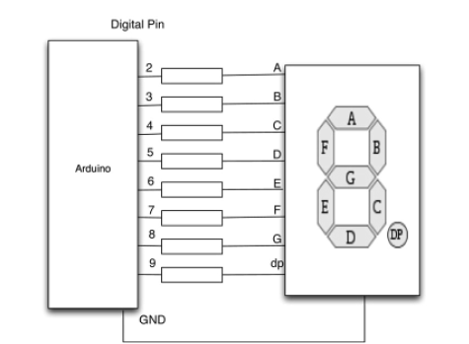

Slide 61
Temprature measure

Slide 62
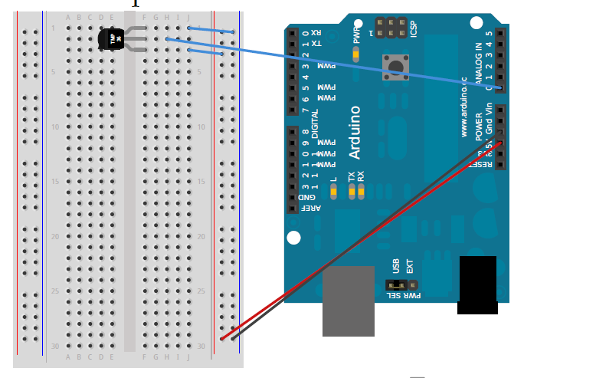

Slide 63
LCD monitor

Slide 64
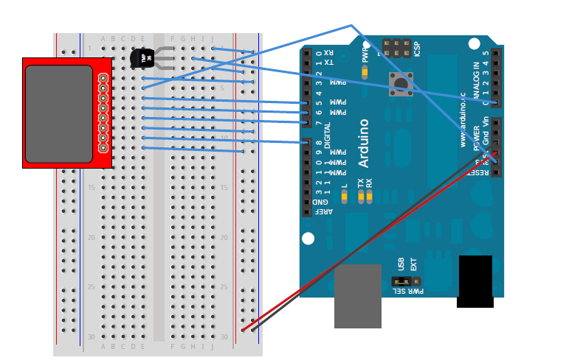

Slide 65
Light sensor

Slide 66
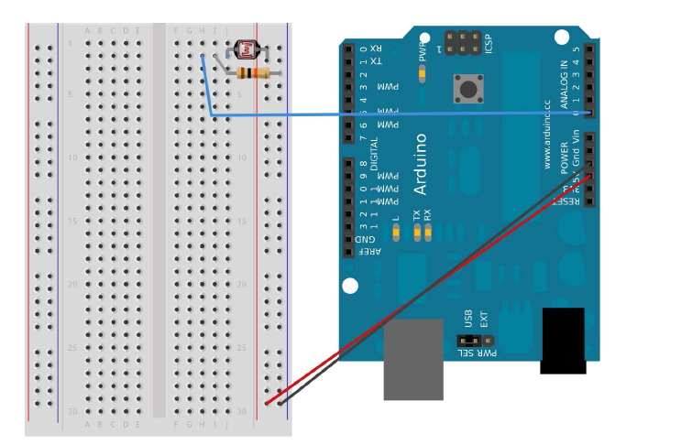

Slide 67
Measuring Distances with an Ultrasonic Sensor

Slide 68
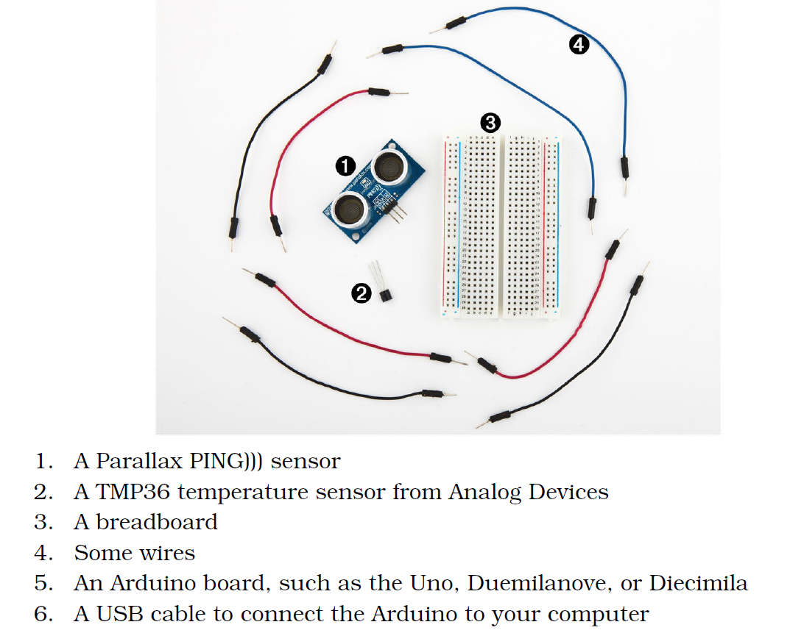

Slide 69
Car or robot arm

Slide 70
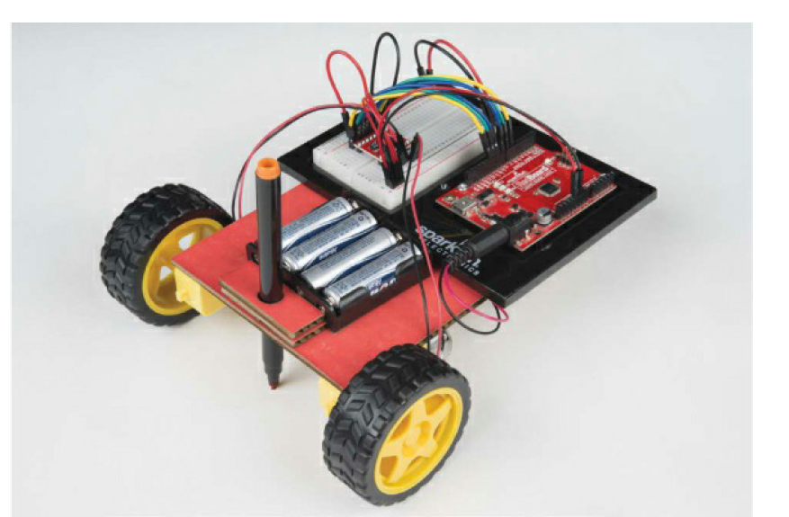

Slide 71
sample
Electronic Parts
• One SparkFun RedBoard (DEV-13975), Arduino Uno (DEV-11021), or any
other Arduino-compatible board
• One USB Mini-B cable (CAB-11301 or your board’s USB cable)
• One solderless breadboard (PRT-12002)
• Two geared hobby motors (ROB-13302*)
• One TB6612FNG H-bridge motor driver (ROB-09457* unsoldered or
ROB-13845* presoldered)
• Two rubber wheels fit for the geared hobby motors (ROB-13259*)
• Male-to-male jumper wires (PRT-11026)
• Male-to-female jumper wires (PRT-09140*)
• One 4 AA battery holder (PRT-09835*)

